Slide 1
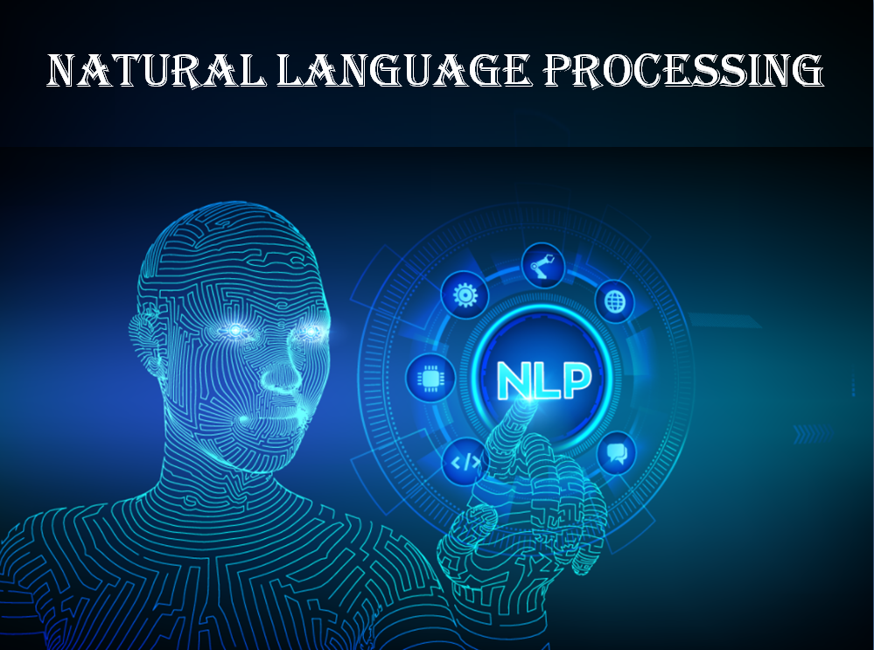
Name of presentation
Company name

Slide 2
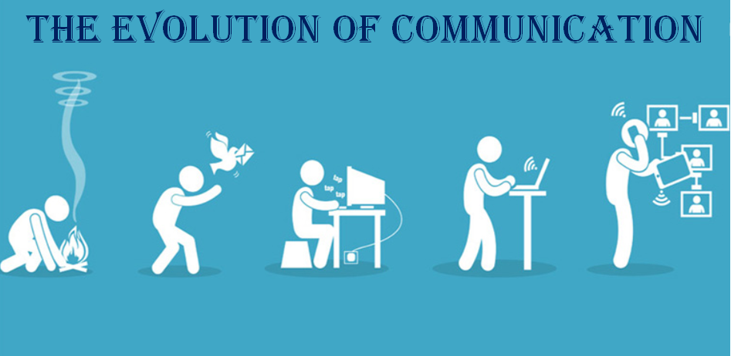
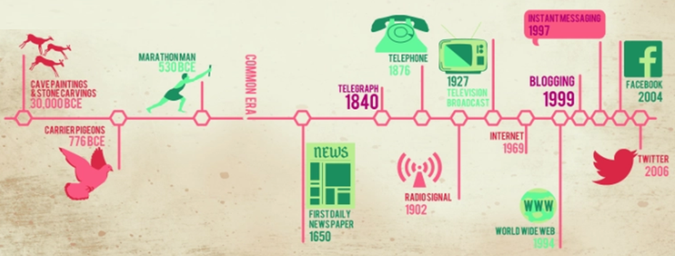
The Evolution of Communication

Slide 3


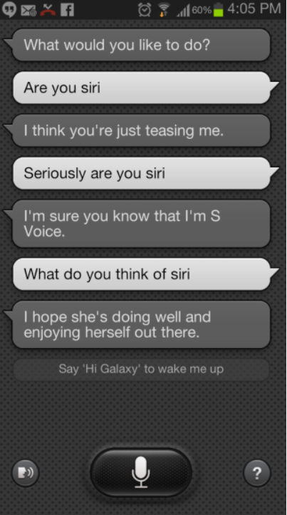
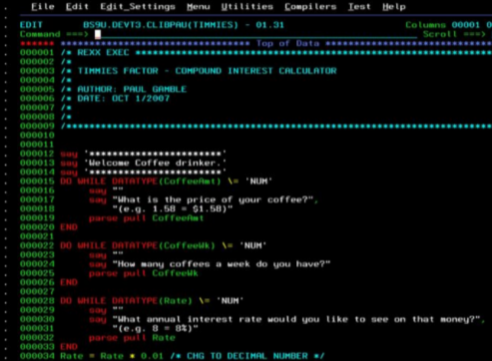
Communication with Machines
~50-70s0
Today
~80s0

Slide 4
AN INTRODUCTION TO NATURAL LANGUAGE PROCESSING
HISTORY OF NATURAL LANGUAGE PROCESSING
COMPONENTS OF NATURAL LANGUAGE PROCESSING
APPLICATIONS OF NATURAL LANGUAGE PROCESSING
LEVELS OF NATURAL LANGUAGE PROCESSING
NATURAL LANGUAGE PROCESSING ROADMAP
TEXT UNDERSTANDING AND NORMALIZATION
NATURAL LANGUAGE PROCESSING LIBRARIES
TEXT UNDERSTANDING AND TEXT NORMALIZATION
UNVEILING OF TEXT
WORD VECTOR REPRESENTATION
Sparse Vector Representations
Dense Vector Representations
SENTENCE EMBEDDING
TASKS OF NLP

Slide 5
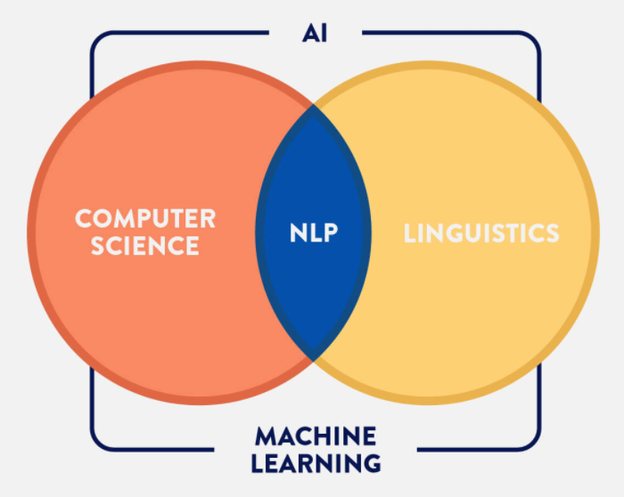


Natural language processing (NLP) is the interdisciplinary field of computer science and linguistics.
NLP allows computers to understand human language — speech or text.

Slide 6

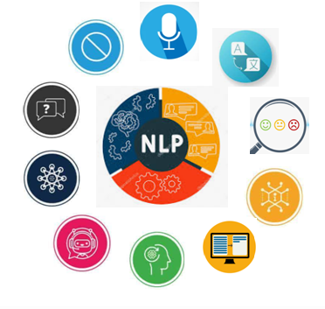








Notable Applications of nlp
Machine Translation
Speech Recognition
Question Answering
Text Summarization
Information Extraction
Sentiment Analysis
Emotion Detection
Spam Detection/Blocking
Dialogue Systems/Chatbots…..

Slide 7
CHATBOTS
Chatbots in healthcare
Molly, Eva, Ginger, Replika, Florence, and Izzy
Chatbots for mental health support
Wysa and Woebot
Chatbots for legal advice
DonotPay, LISA, Ross, and BillyBot

Slide 8
Library/Framework | Capabilities
Natural Language Toolkit (Python) | Provides a suite of open source python modules, data sets, and tutorials. Some of the key features that NLTK provides out of the box include - tokenization, POS tagging, NER, sentiment analysis, corpora (data sets)
spaCy | Open source library for advanced NLP tasks written in Python and Cython. Some of the key features include - tokenization, NER, POS tagging, sentiment analysis, dependency parsing, word vectors for deep learning
Gensim | Open source vector space and topic modelling toolkit implemented in Python. Gensim is popular for its topic modelling, word vectors and corpora
Stanford NLP | Open source NLP package built by the Stanford NLp group. Originally built in Java and now also exposes a Python package. Stanford NLP is typically used to build an NLP pipeline comprising tasks such as tokenization, POS tagging, NER, word vectors for deep learning, and pre trained models for more than 50 languages.

Slide 9
Polyglot | A natural language pipeline that supports massive multilingual applications. Offers the following features in multiple languages: Language detection (196 Languages) Tokenization (165 Languages) Word Embeddings (137 Languages) Sentiment Analysis (136 Languages) Morphological analysis (135 Languages) Transliteration (69 Languages) Named Entity Recognition (40 Languages) Part of Speech Tagging (16 Languages)
scikit-learn | One of the most popular open source machine learning library in Python. Offers a simple to use API to build and test supervised and unsupervised machine learning models
TensorFlow, Keras, PyTorch | Popular deep learning libraries that can be used to train deep neural networks for NLP tasks. Several open source code repositories for common NLP tasks such as sentiment analysis, machine translation, named entity recognition, word vectors etc. have been built using these libraries

Slide 10





Conversational Agents contains:
● Speech recognition
● Language analysis
● Dialogue processing
● Information retrieval
● Text to speech

Slide 11
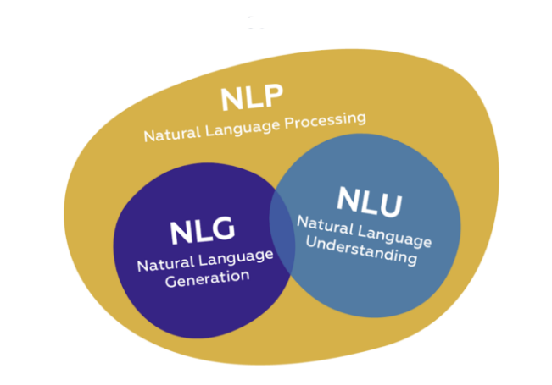
NLP COMPONENTS
NLP converts a text into structured data.
NLU takes up the understanding of the data based on grammar and the context.
→ Understanding involves counting the frequency of terms, identifying named entities, syntactic parsing and semantic role labeling
NLG generates a text based on structured data. (Reponses of chatbots and voice assistants)

Slide 12
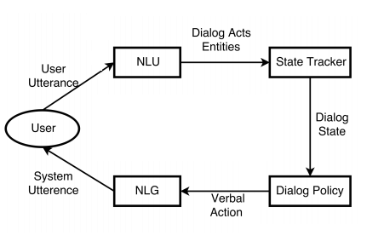
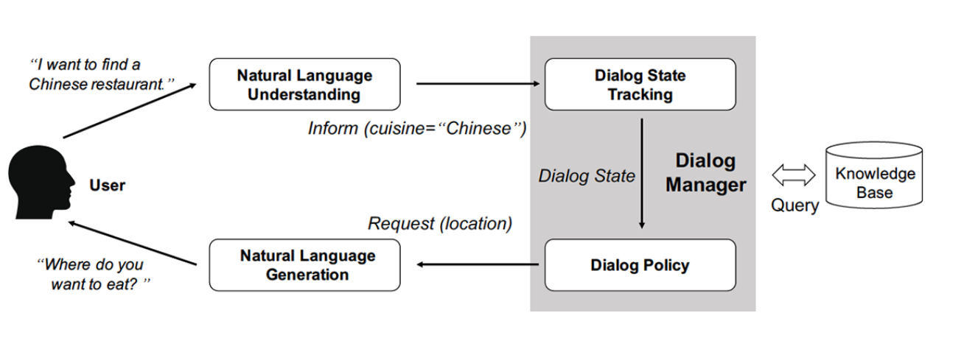

Slide 13
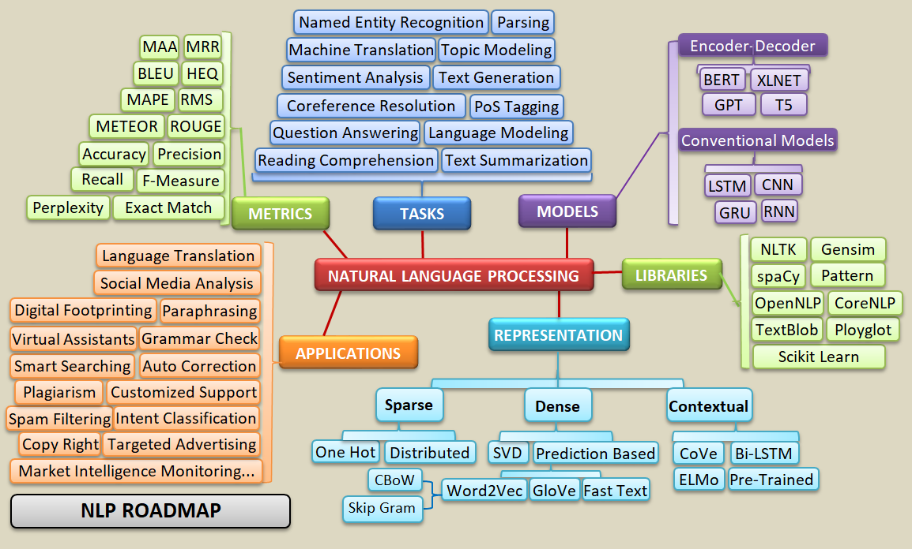

Slide 14
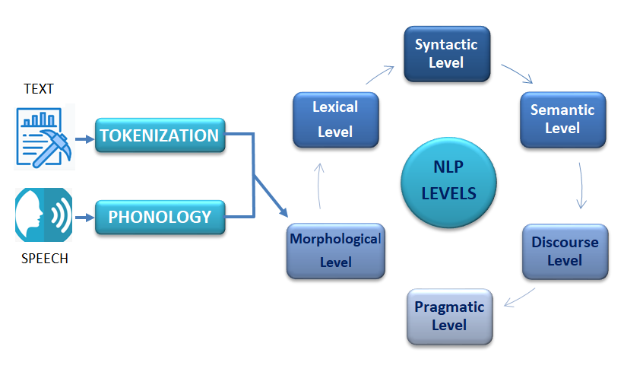
Levels of NLP

Slide 15
DIFFERENT LEVELS OF NLP
1 Phonological level
2 Morphological level
3 Lexical level
4 Syntactic level
5 Semantic level
6 Discourse level
7 Pragmatic level

Slide 16
1. Phonetic or phonological level
Phonemes & Syllables
A phoneme is a unit of sound that can distinguish one word from another word in a particular language.
A syllable is a unit of organization for a sequence of speech sounds.
Rays→Raise→Raze

Slide 17
2. Morphological level
Morpheme is the smallest meaningful lexical item in a language.
Morphemes, Prefix, Suffix, Inflections/derivations
Unhappiness
Stem
3. Lexical Level
The study of words with respect to their lexical meaning and part-of-speech.
→ Duck, Chair – noun / verb

Slide 18
4. Syntactic level
Deals with grammar and structure of sentences.
Eg: Who is the president of US?
President, US?
NLP is much more than syntax!
Syntax analyses don’t fully nail down the meaning
→ “ I haven’t slept for ten days”
→“ I clapped because it’s finished, not because I like it.”

Slide 19


Slide 20
5. Semantic level
Deals with the meaning of words and sentences.
→The chicken is ready to eat.
→ I sent the bill to john
Bat, cricket, bank, bear…
“The coach lost a set”
coach has 15 senses, lose has 11 & set has 91 senses
possible Translations-(15 x 11 x 91 = 15015)
WORDNET

Slide 21
WORDNET
https://wordnet.princeton.edu/
Text data is highly unstructured in nature. According to WordNet, In a lexical reference system a word has an average of 1.4 senses. WordNet is the sem Verbs - 2.1/Word
Adjectives - 1.45/Word
Adverbs - 1.25/Word
Nouns - 1.24/Word antic dictionary of English words with interlinked semantic relations.

Slide 22
6. Discourse level Deals with the structure of different kinds of text.
(Anaphoric, Cataphoric and Exophoric Referencing)
Anaphoric : word or phrase - earlier in the discourse.
Eg: John went to the bank. He was annoyed because it was closed.
Cataphoric : later
Eg: The book was there on the table. I’d never read Moby Dick and I didn’t intend to do so now.
Exophoric : outside
Eg: “They‘re late again, can you believe it?” “I know! Well, they’d better get here soon or it‘ll get cold.”

Slide 23
7. Pragmatic level
Deals with the use of real-world knowledge and understanding of how this impacts the meaning of what is being communicated.
Eg: The height of the tallest building in the world has 828-metres.

Slide 24
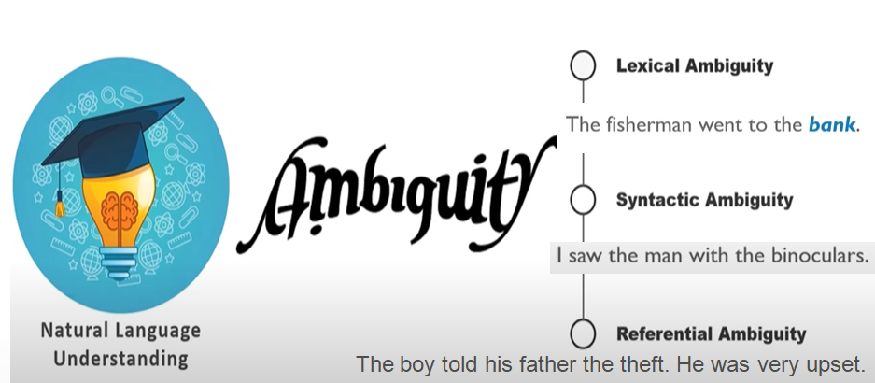
Complexities in NLP Ambiguity

Slide 25
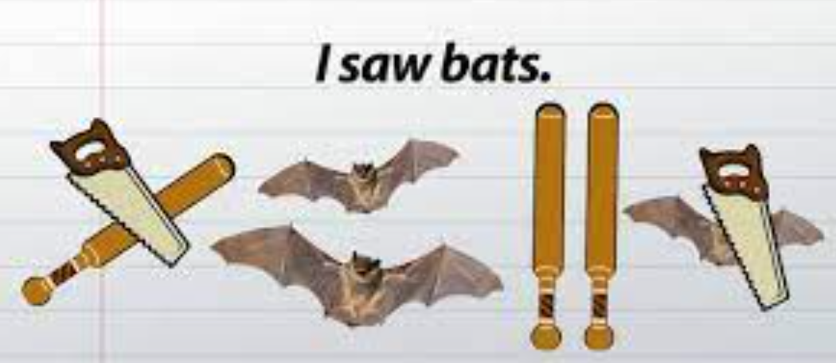

Syntactic Ambiguity

Slide 26
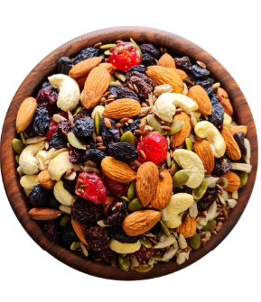

Semantic Ambiguity
Mixed Nuts

Slide 27
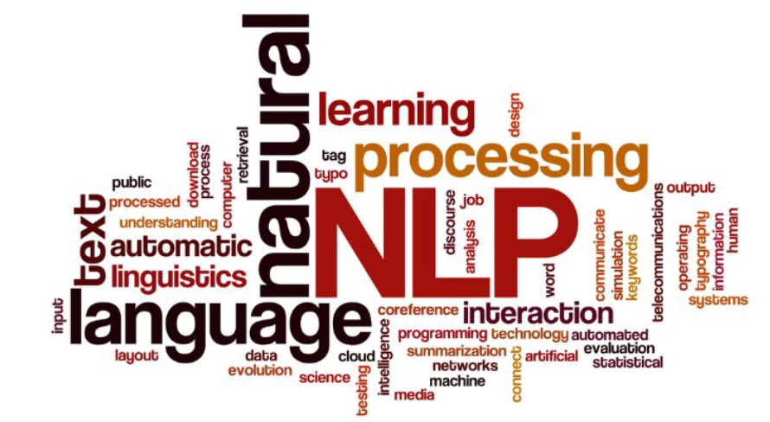
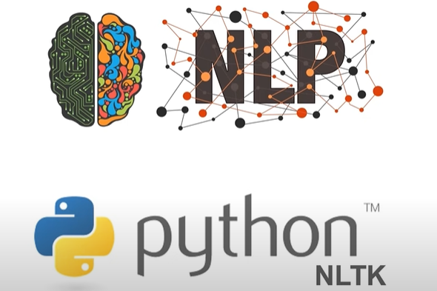
TEXT MINING
Text Mining/Text Analysis is a process of deriving meaningful information from Natural Language text.
Unstructured Format (Structured-Semi-Unstructured)
Word Sense Ambiguities
Semantic Similarity conflicts
Named Entity Recognition

Slide 28
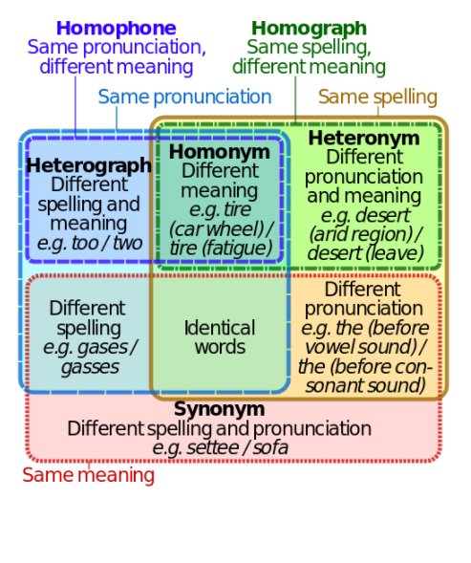
Word Sense Ambiguities:-
Acronyms : WHO
Abbreviations : Dr., Prof., Inc,
Polysemy : Bat, Bank
Homographs : Lead
Heterograph : too/two
Synonymy : Beautiful→Lovely, Pretty

Slide 29
Semantic Similarity conflicts :-
Phrases, idioms and expressions
→ It's a piece of cake (It's easy)
Cross Lingual Similarity(extonyms, endonyms)
→India-Bharath
→Japan-Nihon/Nippon
Paraphrase Matching
→ The plane leaves at 12.pm. ~ The flight departs at noon.
Anaphoric, Cataphoric and Exophoric references

Slide 30
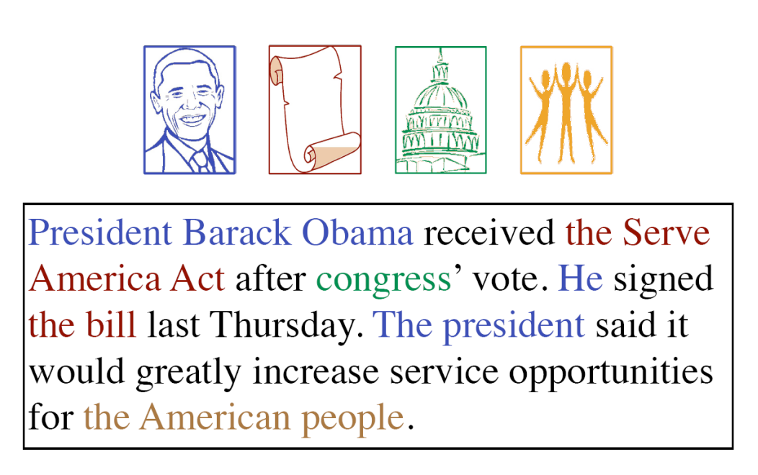
Named Entity Recognition :- In NER, the tedious task is to detect the tagged word is verb, noun, adjective or adverb.

Slide 31
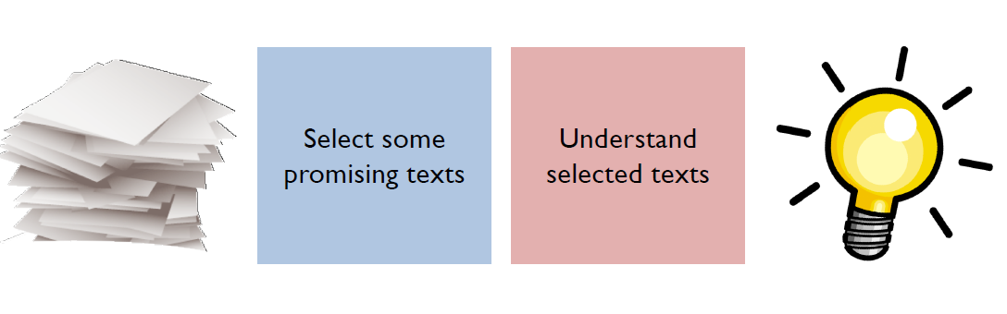
Information Access in Two Steps

Slide 32
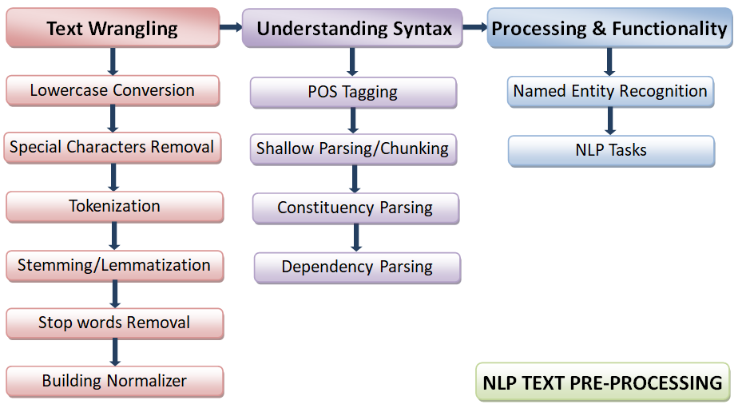
TEXT PROCESSING STEPS

Slide 33
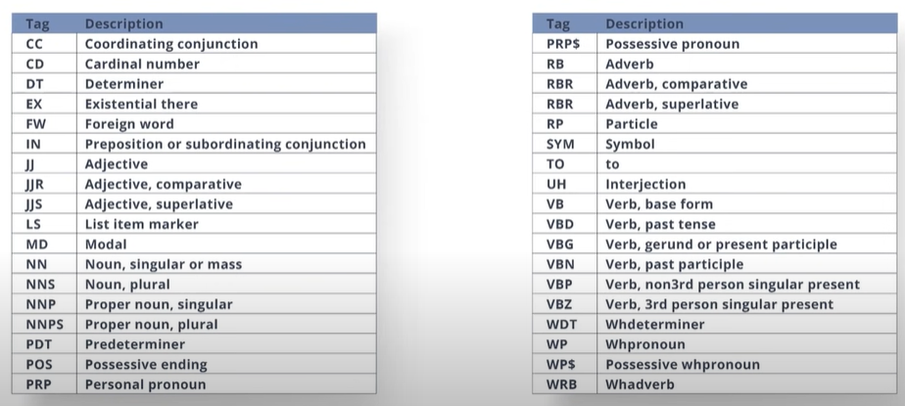
POS - TAG

Slide 34
Platforms/Services provided by Amazon over Amazon Web Services
Amazon Comprehend: NLP service that uses machine learning to find insights in text. You can perform language detection, named entity recognition, sentiment analysis, POS tagging, and topic modelling using this service
Amazon Lex: Service for building conversational interfaces using voice or text. Provides automatic speech recognition and natural language understanding capabilities
Amazon Polly: Service that converts text into life like speech in 25+ languages
Amazon Transcribe: Service with automatic speech recognition capabilities that converts speech to text. Can transcribe speech in real-time as well.
Amazon Translate: A neural machine translation service that delivers fast, high quality and affordable machine translation.
Amazon Textract: A service that automatically extracts text and data from scanned documents.

Slide 35
Platforms/Services provided by Google over Google Cloud Platform
Google Cloud Natural Language: Perform syntax analysis, entity analysis, custom entity extraction, sentiment analysis, content classification, and build machine learning models on cloud
Google Cloud Translation: Dynamically translate between multiple languages.
Google Cloud Speech-to-Text API: Performs speech recognition across 120 different languages
Google Cloud Text-to-Speech API: Synthesize natural sounding speech in 32 different voices across multiple languages and variants
DialogFlow: Enables the end-to-end development of conversational interfaces (chatbots) across devices and platforms.

Slide 36
Platforms/Services provided by Microsoft over Microsoft Azure
Microsoft Cognitive Services - Speech Services: Automatic speech-to-text transcription, Natural text-to-speech, and real time speech translation
Microsoft Cognitive Services - Text Analytics: Named Entitry Recognition (NER), Key Phrase Extraction, Sentiment Analysis
Microsoft Cognitive Services - Translator Text: Automatic language detection and text translation
Microsoft Cognitive Services - QnA Maker: QnA extraction from text, Create knowledge base from set of QnAs, Semantic matching for knowledge bases
Microsoft Azure Bot Service: End-to-end development of intelligent, enterprise-grade chatbots
Microsoft Cognitive Services - Language Understanding (LUIS): Build natural language understanding into your apps, bots and IoT devices

Slide 37

Thank you

